Slide 1
How to Use: Aftermarket Resource Center

Slide 2
How to get to the Website
What products can be looked up
How to look up by Equipment
How to look up by Material Number
How to look up Warranty Status using Serial Number
How to look up using Model Number
How to look up Parts and P&A for Water Source Heat Pumps (WSHP)
How to use the Cart function
General Tool Functions & Tips
How to get to Self-Help Options

Slide 3
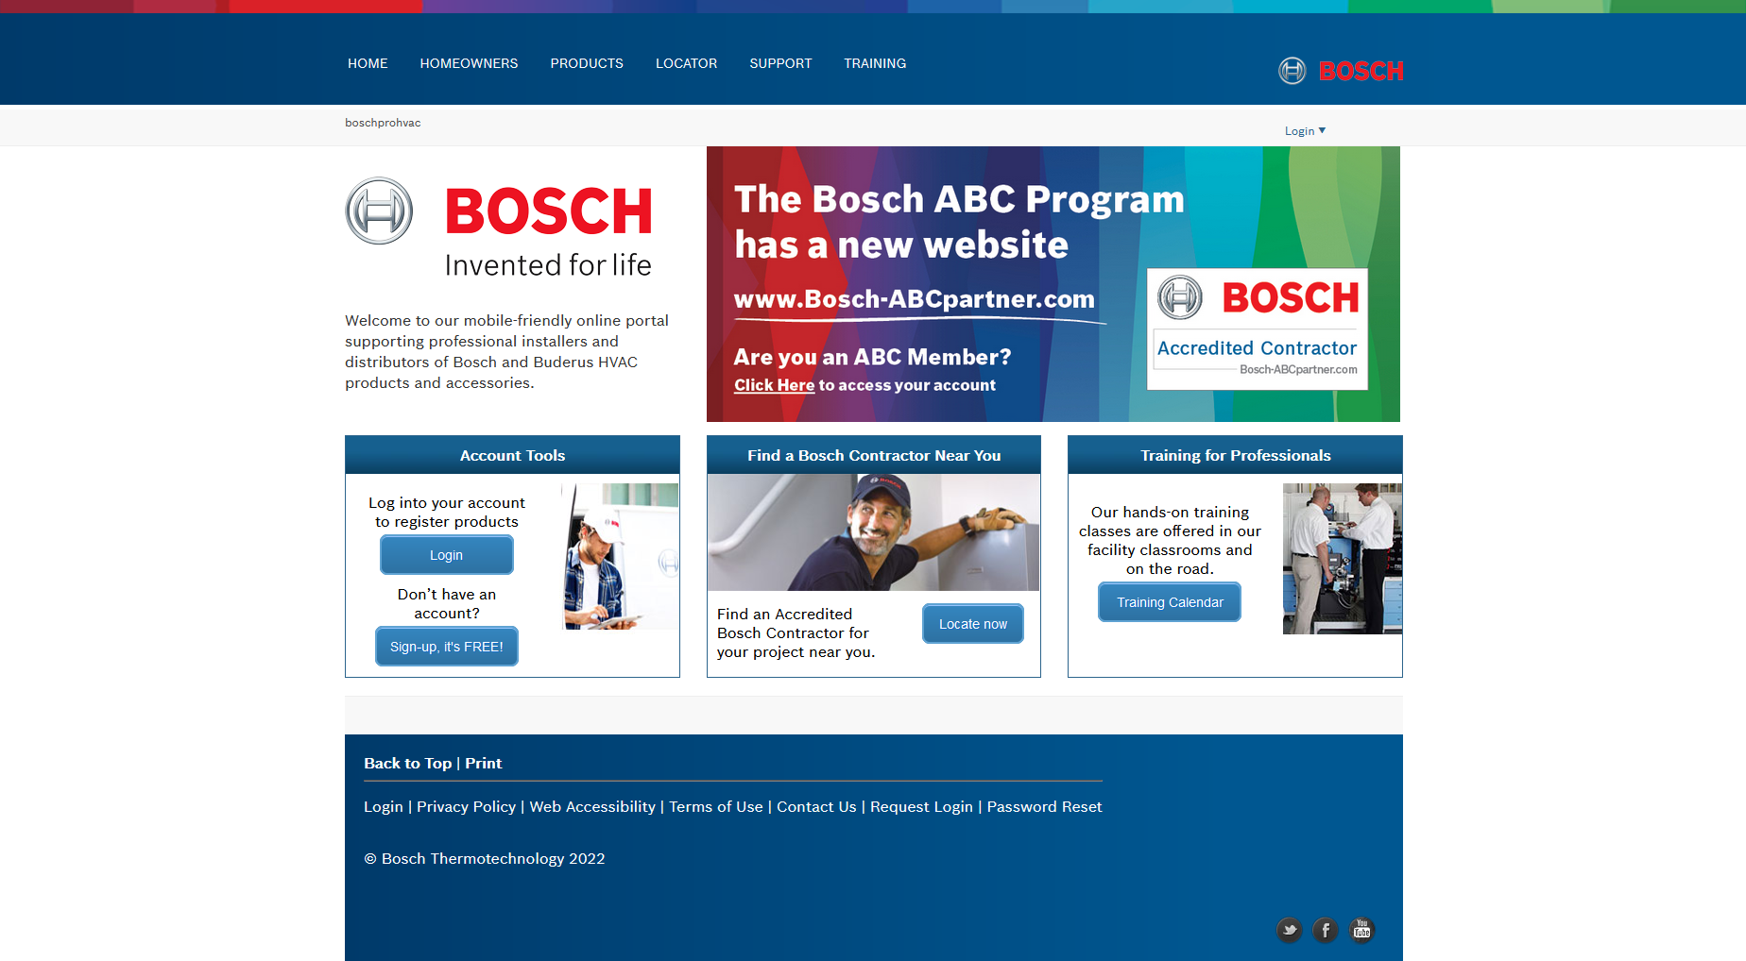
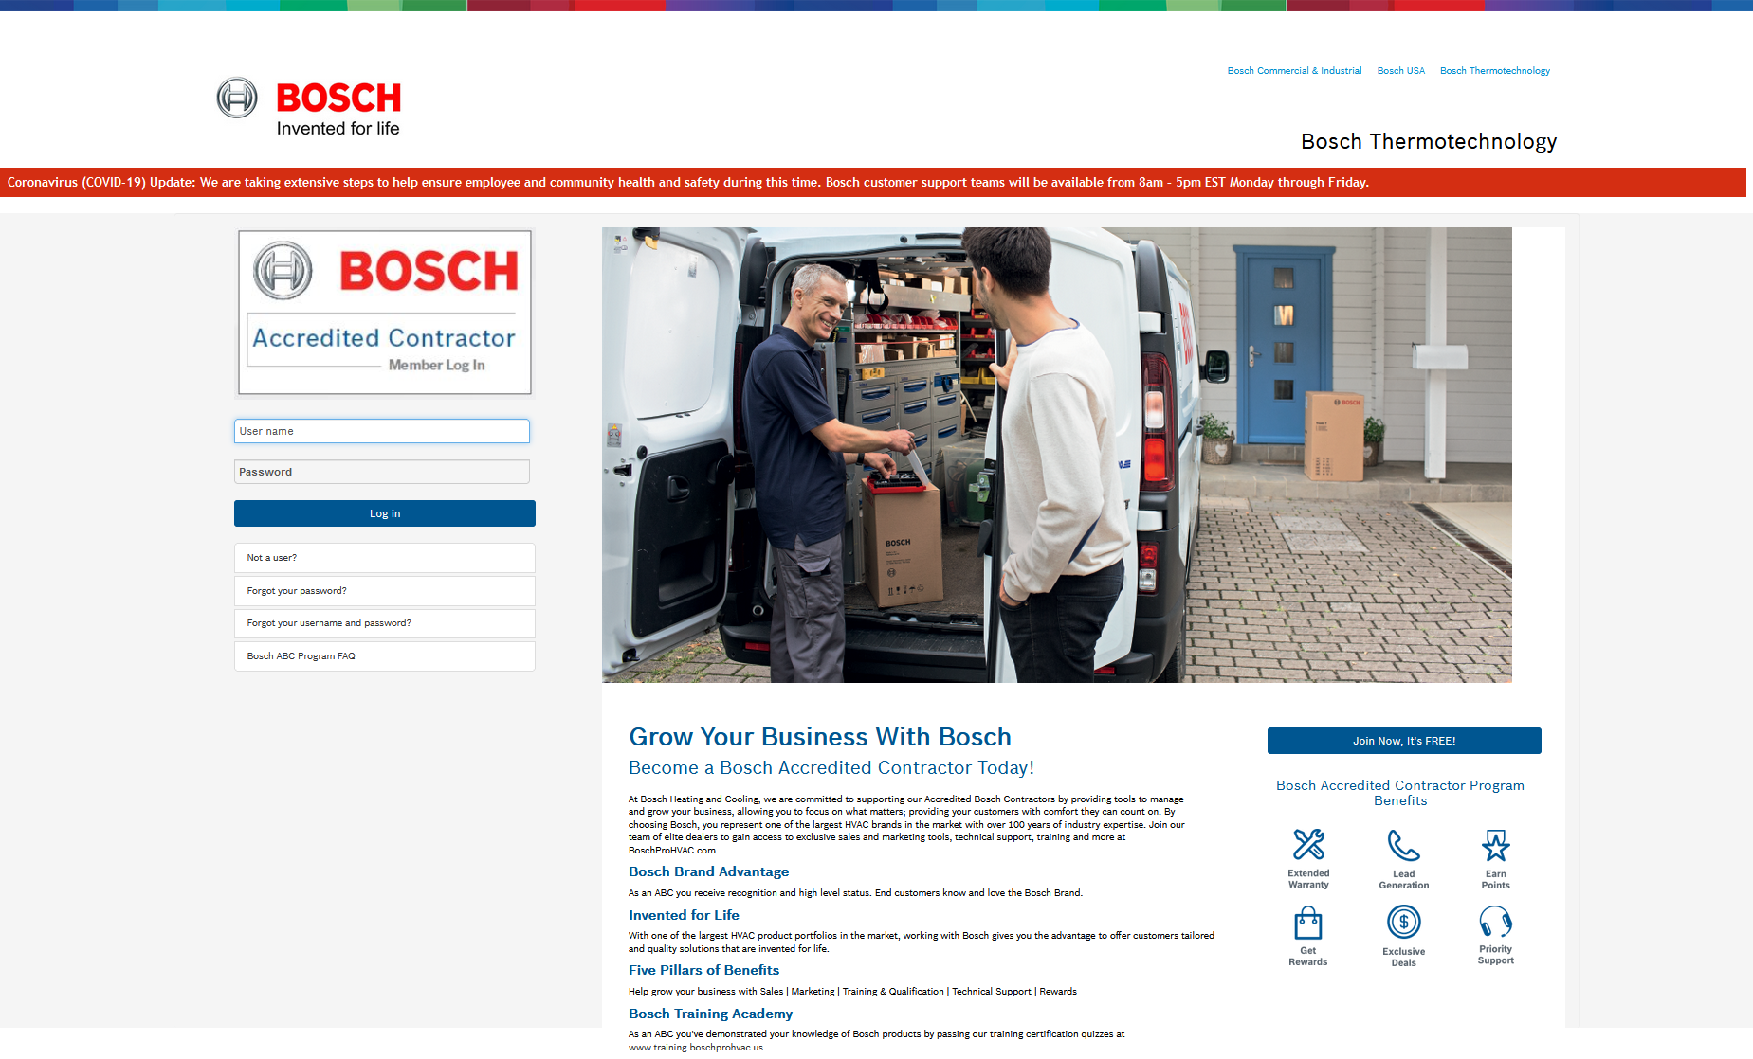
How to get to the Website
Aftermarket Resource Center Training
Commercial & Industrial Website
Home page tile: Aftermarket Resource Center
Service tab:
Warranty & Claims
Spare Parts Finder
Product Warranty Library
Warranty At-A-Glance tile
Residential Website
Home page tile: Aftermarket Resource Center
Service tab:
Warranty At-A-Glance
Spare Parts Finder
Technical Documentation
Warranty & Claims
BoschProHVAC Website
ABC Website

Slide 4
What products can be looked up
Aftermarket Resource Center Training
Tankless
Boiler
Indirect Tank
Controls
Radiators
IDS
Minisplits
Furnace
Cased Coils
Water Source Heat Pumps (WSHP)

Slide 5
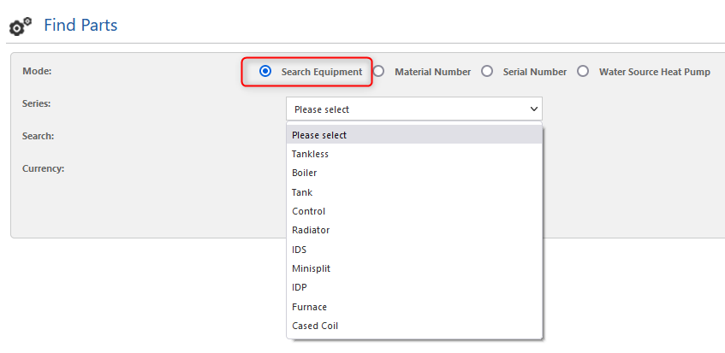
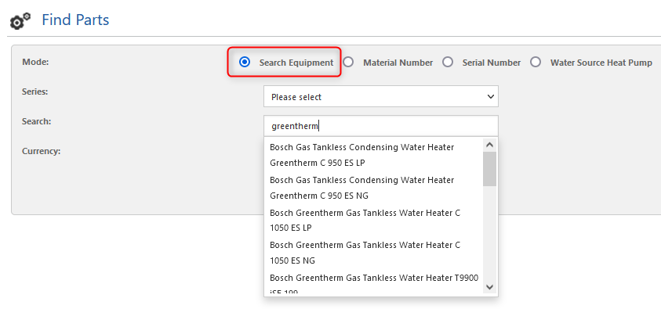
How to look up by Equipment
Aftermarket Resource Center Training
Select Search Equipment Mode
Option 1: Select the appropriate product in the Series drop-down and then click the Search button.
Option 2: Type key words into the Search box. As you type, drop-down options may populate for specific products–you may select one or keep your typed keyword. Then click the Search button.
You can look up equipment by performing Option 1 and/or Option 2.

Slide 6
How to look up by Material Number
Aftermarket Resource Center Training
Select the Material Number Mode
Enter your Material Number (also known as Part Number)
Click Search

Slide 7
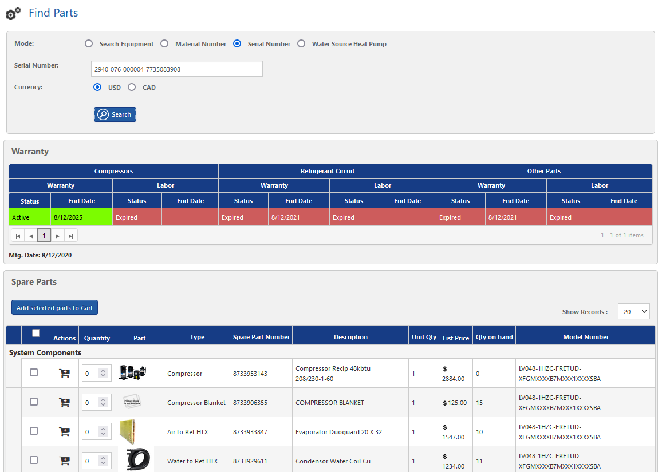
How to look up Warranty Status by using Serial Number
Aftermarket Resource Center Training
Select Serial Number Mode
Enter your full Serial Number (including dashes)
Click Search
Functions of this lookup & Tips:
Looking up by Serial Number is the best way to get the most accurate warranty terms
This search will display specific warranty terms and a Spare Parts list
Tip: Bookmark the Warranty At-A-Glance tool for convenient warranty look-up taking you directly to the Serial Number search
Serial Number Locator

Slide 8
How to look up using Model Number
Aftermarket Resource Center Training
Select the Search Equipment Mode.
Enter your Model Number into the Search box
Click Search

Slide 9
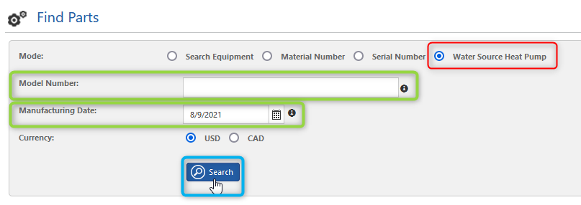
How to look up Parts and P&A for Water Source Heat Pumps (WSHP)
Aftermarket Resource Center Training
Select the Water Source Heat Pump Mode
Enter your Model Number *
Select the Manufacturing Date **
Click Search
* Model number search should only be used when a Serial Number is not available. A minimum of the first 15 digits of the codestring are recommended, dashes included and add an asterisk at the end. For example: SM036-1VTC*. An asterisk is only needed when the full 40-digit Model Number is not provided. Question marks can be used as wild characters when searching. When a more specific search is needed, such as getting all spare parts for vertical LV units, you can perform a search as follows: LV???-?VTC*. You can use a ? wild character on any digit of the codestring.
** Manufacturing date is the date of when the unit was produced. If a unit was built differently after given date, results will not show components used prior to that date.

Slide 10
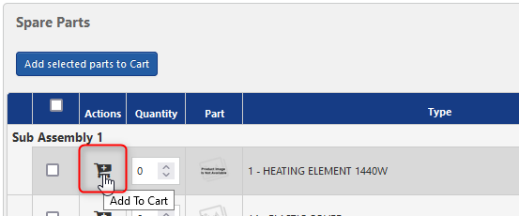
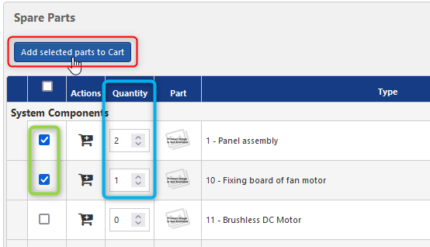
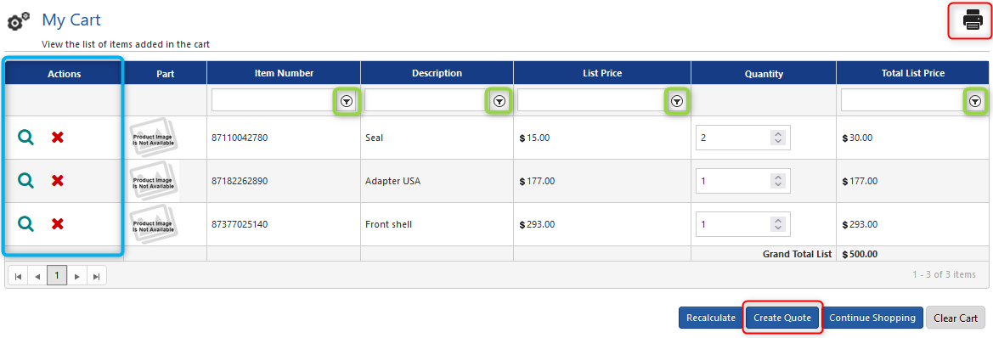
How to use the Cart Function
Aftermarket Resource Center Training
Adding Parts to Cart
Option 1: Click the Cart icon in the row of the desired part
Option 2: Select the desired parts’ checkbox, select the desired Quantity, and click Add selected parts to Cart at the top of the Spare Parts section
View your cart by clicking the Cart icon at the top right of the screen
Functions in the Cart:
Review your created parts list/quote
Remove parts and edit part quantity
Filter your list
Print your parts list/quote
View part details?
NOTE: Users cannot currently make purchases on the site

Slide 11
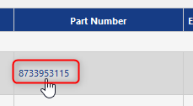
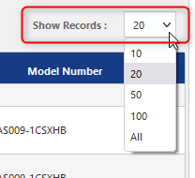
General Tool Functions & Tips
Aftermarket Resource Center Training
Find the product you’re looking for along with relating information:
Clicking on the Part Number will take you to the Spare Parts list, price, and availability for that part
Adjust the number of results that display per page by selecting the desired about in the “Show Records” drop-down option

Slide 12
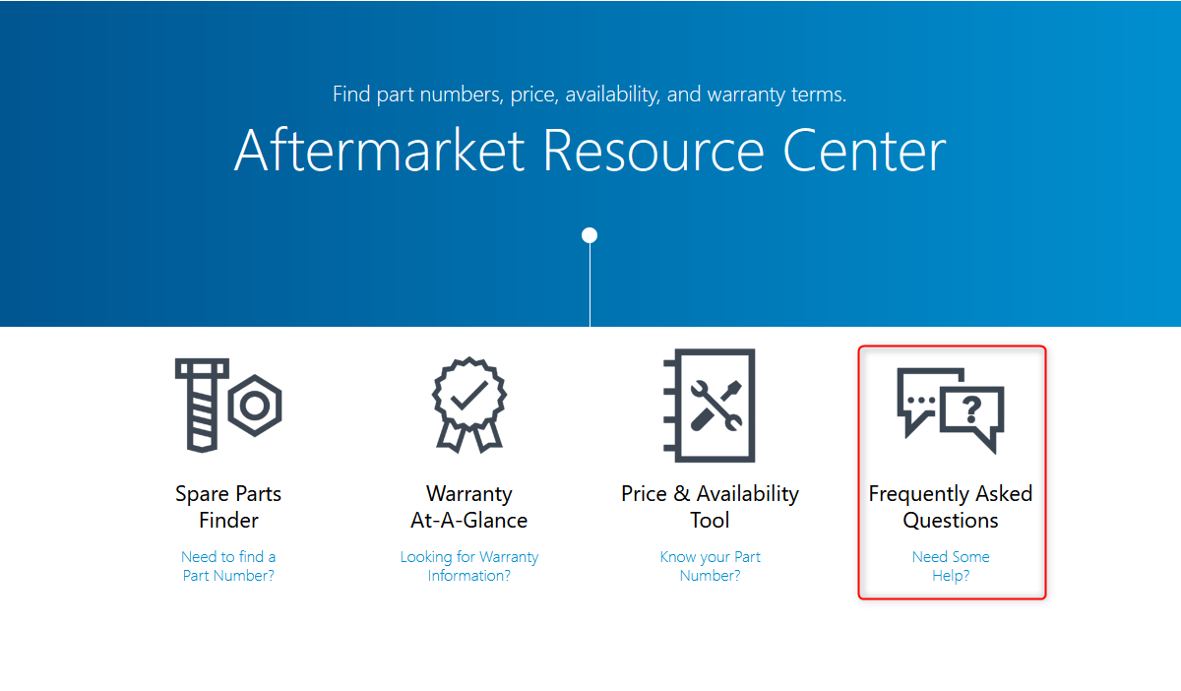
How to get to Self-Help Options
Aftermarket Resource Center Training
Frequently Asked Questions link on the tool Homepage and within the tool
Residential Website
Commercial Website

